Slide 1
Fundamentals of the Analysis of Algorithm Efficiency
Algorithm analysis framework
Asymptotic notations
Analysis of non-recursive algorithms
Analysis of recursive algorithms

Slide 2
Expected Outcomes
The students should be able to
List the key steps in an algorithm’s analysis framework
Define the three asymptotic notations and explain their relations
Compare the asymptotic growth rate of two given functions by using the definition of asymptotic notation or Limits
Describe the key steps in analysis of a non-recursive algorithm and a recursive algorithm
Use different ways to transform a recurrence relation into its closed form
Analyze the time complexity of recursive algorithm for computing the nth Fibonacci number

Slide 3
Analysis of Algorithms
Analysis of algorithms means to investigate an algorithm’s efficiency with respect to resources: running time and memory space.
Time efficiency: how fast an algorithm runs.
Space efficiency: the space an algorithm requires.
Typically, algorithms run longer as the size of its input increases
We are interested in how efficiency scales with respect to input size

Slide 4
Analysis Framework
Measuring an input’s size
Measuring running time
Orders of growth (of the algorithm’s efficiency function)
Worst-base, best-case and average-case efficiency

Slide 5
Measuring Input Sizes
Efficiency is defined as a function of input size.
Input size depends on the problem.
Example 1, what is the input size of the problem of sorting n numbers?
Example 2, what is the input size of adding two n by n matrices?

Slide 6
Units for Measuring Running Time
Should we measure the running time using standard unit of time measurements, such as seconds, minutes?
Depends on the speed of the computer.
Count the number of times each of an algorithm’s operations is executed.
Difficult and unnecessary
Count the number of times an algorithm’s basic operation is executed.
Basic operation: the operation that contributes the most to the total running time.
For example, the basic operation is usually the most time-consuming operation in the algorithm’s innermost loop.

Slide 7
Order of growth
Most important: Order of growth within a constant multiple as n→∞
Example:
How much faster will algorithm run on computer that is twice as fast?
How much longer does it take to solve problem of double input size?
Notes:
Example: cn²
how much faster on twice as fast computer? (2)
how much longer for 2n? (4)

Slide 8
Input size and basic operation examples
Problem | Input size measure | Basic operation
Searching for key in a list of n items | Number of list’s items, i.e. n | Key comparison
Multiplication of two matrices | Matrix dimensions or total number of elements | Multiplication of two numbers
Checking primality of a given integer n | n’size = number of digits (in binary representation) | Division
Typical graph problem | #vertices and/or edges | Visiting a vertex or traversing an edge

Slide 9
Theoretical Analysis of Time Efficiency
Time efficiency is analyzed by determining the number of repetitions of the basic operation as a function of input size.
Assuming C(n) = (1/2)n(n-1),
how much longer will the algorithm run if we double the input size?
input size
The efficiency analysis framework ignores the multiplicative constants of C(n) and focuses on the orders of growth of the C(n).
T(n) ≈ c_{op}C (n)
running time
execution time
for the basic operation
Number of times the basic operation is executed

Slide 10
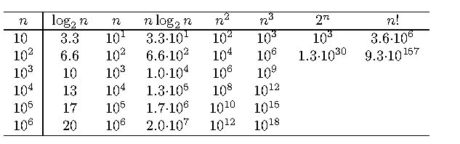
Orders of Growth
Exponential-growth functions
Orders of growth:
consider only the leading term of a formula
ignore the constant coefficient.

Slide 12
Worst-Case, Best-Case, and Average-Case Efficiency
Algorithm efficiency depends on the input size n
For some algorithms efficiency depends on type of input.
Example: Sequential Search
Problem: Given a list of n elements and a search key K, find an element equal to K, if any.
Algorithm: Scan the list and compare its successive elements with K until either a matching element is found (successful search) or the list is exhausted (unsuccessful search)
Given a sequential search problem of an input size of n,
what kind of input would make the running time the longest?
How many key comparisons?

Slide 13
Sequential Search Algorithm
ALGORITHM SequentialSearch(A[0..n-1], K)
//Searches for a given value in a given array by sequential search
//Input: An array A[0..n-1] and a search key K
//Output: Returns the index of the first element of A that matches K or –1 if there are no matching elements
i ←0
while i < n and A[i] ‡ K do
i ← i + 1
if i < n //A[I] = K
return i
else
return -1

Slide 14
Worst-Case, Best-Case, and Average-Case Efficiency
Worst case Efficiency
Efficiency (# of times the basic operation will be executed) for the worst case input of size n.
The algorithm runs the longest among all possible inputs of size n.
Best case
Efficiency (# of times the basic operation will be executed) for the best case input of size n.
The algorithm runs the fastest among all possible inputs of size n.
Average case:
Efficiency (#of times the basic operation will be executed) for a typical/random input of size n.
NOT the average of worst and best case
How to find the average case efficiency?

Slide 15
Summary of the Analysis Framework
Both time and space efficiencies are measured as functions of input size.
Time efficiency is measured by counting the number of basic operations executed in the algorithm. The space efficiency is measured by the number of extra memory units consumed.
The framework’s primary interest lies in the order of growth of the algorithm’s running time (space) as its input size goes infinity.
The efficiencies of some algorithms may differ significantly for inputs of the same size. For these algorithms, we need to distinguish between the worst-case, best-case and average case efficiencies.

Slide 16
Asymptotic Growth Rate
Three notations used to compare orders of growth of an algorithm’s basic operation count
O(g(n)): class of functions f(n) that grow no faster than g(n)
Ω(g(n)): class of functions f(n) that grow at least as fast as g(n)
Θ (g(n)): class of functions f(n) that grow at same rate as g(n)

Slide 17
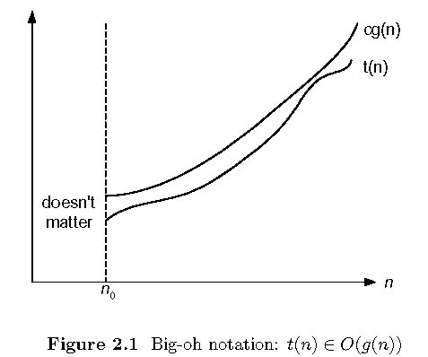
O-notation

Slide 18
O-notation
Formal definition
A function t(n) is said to be in O(g(n)), denoted t(n) ∈O(g(n)), if t(n) is bounded above by some constant multiple of g(n) for all large n, i.e., if there exist some positive constant c and some nonnegative integer n₀ such that
t(n) ≤ cg(n) for all n ≥ n₀
Exercises: prove the following using the above definition
10n² ∈ O(n²)
10n² + 2n ∈ O(n²)
100n + 5 ∈ O(n²)
5n+20 ∈ O(n)

Slide 19
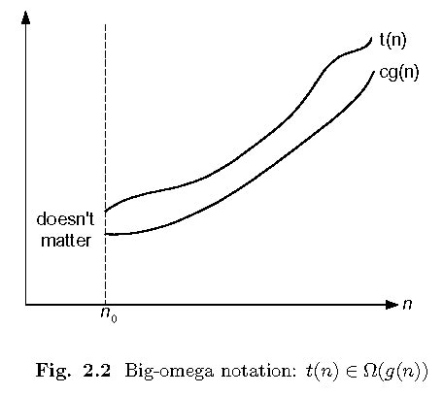
Ω-notation

Slide 20
Ω-notation
Formal definition
A function t(n) is said to be in Ω(g(n)), denoted t(n) ∈ Ω(g(n)), if t(n) is bounded below by some constant multiple of g(n) for all large n, i.e., if there exist some positive constant c and some nonnegative integer n₀ such that
t(n) ≥ cg(n) for all n ≥ n₀
Exercises: prove the following using the above definition
10n² ∈ Ω(n²)
10n² + 2n ∈ Ω(n²)
10n³ ∈ Ω(n²)

Slide 21
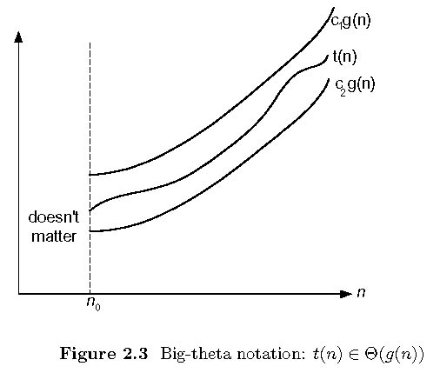
Θ-notation

Slide 22
Θ-notation
Formal definition
A function t(n) is said to be in Θ(g(n)), denoted t(n) ∈ Θ(g(n)), if t(n) is bounded both above and below by some positive constant multiples of g(n) for all large n, i.e., if there exist some positive constant c₁ and c₂ and some nonnegative integer n₀ such that
c₂ g(n) ≤ t(n) ≤ c₁ g(n) for all n ≥ n₀
Exercises: prove the following using the above definition
10n² ∈ Θ(n²)
10n² + 2n ∈ Θ(n²)
(1/2)n(n-1) ∈ Θ(n²)

Slide 23
>=
Ω(g(n)), functions that grow at least as fast as g(n)
=
Θ(g(n)), functions that grow at the same rate as g(n)
g(n)
<=
O(g(n)), functions that grow no faster than g(n)

Slide 24
Some Properties of Asymptotic Order of Growth
f(n) ∈ O(f(n))
f(n) ∈ O(g(n)) iff g(n) ∈Ω(f(n))
If f (n) ∈ O(g (n)) and g(n) ∈ O(h(n)) , then f(n) ∈ O(h(n)) Note similarity with a ≤ b
If f₁(n) ∈ O(g₁(n)) and f₂(n) ∈ O(g₂(n)) , then
f₁(n) + f₂(n) ∈ O(max{g₁(n), g₂(n)})
The analogous assertions are true for the Ω-notation and Θ-notation.

Slide 25
Some Properties of Asymptotic Order of Growth
If f₁(n) ∈ O(g₁(n)) and f₂(n) ∈ O(g₂(n)) , then
f₁(n) + f₂(n) ∈ O(max{g₁(n), g₂(n)})
Implication: The algorithm’s overall efficiency will be determined by the part with a larger order of growth.
For example,
5n² + 3nlogn ∈ O(n²)

Slide 26
Using Limits for Comparing Orders of Growth
0 order of growth of T(n) < order of growth of g(n)
lim_{n→∞} T(n)/g(n) =
c>0 order of growth of T(n) = order of growth of g(n)
∞ order of growth of T(n) > order of growth of g(n)
Examples:
10n vs. 2n²
n(n+1)/2 vs. n²
log_{b} n vs. log_{c} n

Slide 27
L’Hôpital’s rule
If lim_{n→∞} f(n) = lim_{n→∞} g(n) = ∞ and the derivatives f ´, g ´ exist, Then
f(n)
g(n)
f ´(n)
g ´(n)
lim
n→∞
=
lim
n→∞
Example:
log₂n vs. n
2^{n} vs. n!
Stirling’s formula: n! ≈ (2πn)^{1/2} (n/e)^{n}

Slide 28
Orders of growth of some important functions
All logarithmic functions log_{a} n belong to the same class Θ(log n) no matter what the logarithm’s base a > 1 is.
All polynomials of the same degree k belong to the same class: a_{k}n^{k} + a_{k-1}n^{k-1} + … + a₀ ∈ Θ(n^{k}).
Exponential functions a^{n} have different orders of growth for different a’s.
order log n < order n^{α} (α>0) < order a^{n} < order n! < order n^{n}

Slide 29
Basic Efficiency classes
The time efficiencies of a large number of algorithms fall into only a few classes.
fast
1 | constant
log n | logarithmic
n | linear
n log n | n log n
n² | quadratic
n³ | cubic
2^{n} | exponential
n! | factorial
High time efficiency
slow
low time efficiency

Slide 30
Summary of How to Establish Orders of Growth of an Algorithm’s Basic Operation Count
Method 1: Using limits.
L’Hôpital’s rule
Method 2: Using the properties
Method 3: Using the definitions of O-, Ω-, and Θ-notation.

Slide 31
Time Efficiency of Nonrecursive Algorithms
Steps in mathematical analysis of nonrecursive algorithms:
Decide on parameter n indicating input size
Identify algorithm’s basic operation
Check whether the number of times the basic operation is executed depends only on the input size n. If it also depends on the type of input, investigate worst, average, and best case efficiency separately.
Set up summation for C(n) reflecting the number of times the algorithm’s basic operation is executed.
Simplify summation using standard formulas (see Appendix A)

Slide 32
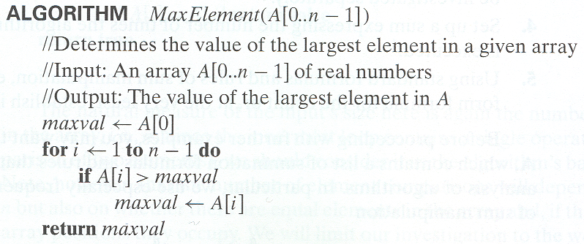
Example 1: Maximum element

Slide 33
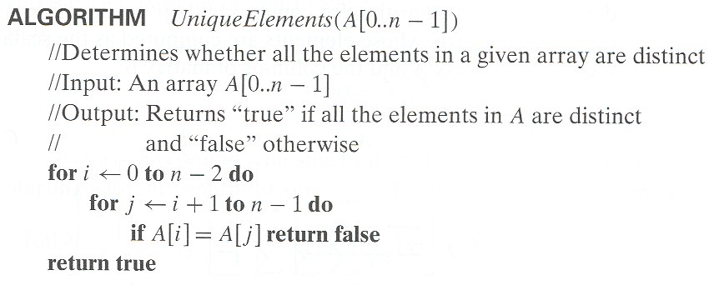
Example 2: Element uniqueness problem

Slide 34
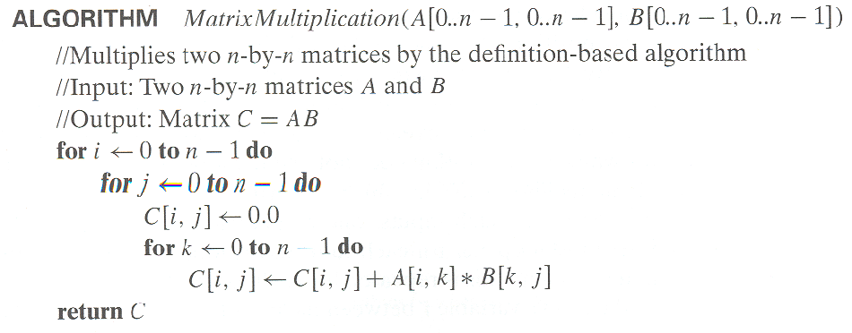
Example 3: Matrix multiplication

Slide 35
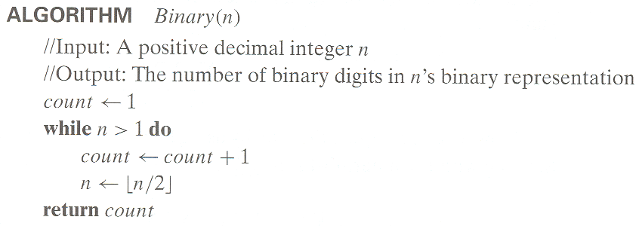
Example 4: Counting binary digits
It cannot be investigated the way the previous examples are. We will analyze it in the following part.

Slide 36
Mathematical Analysis of Recursive Algorithms
Recursive evaluation of n!
Recursive solution to the Towers of Hanoi puzzle
Recursive solution to the number of binary digits problem

Slide 37
Example 1: Recursive evaluation of n !
Iterative Definition
Recursive definition
Algorithm F(n)
F(n) = 1 if n = 0
= n * (n-1) * (n-2)… 3 * 2 * 1 if n > 0
F(n) = 1 if n = 0
F(n) = n * F(n-1) if n > 0
if n=0
return 1 //base case
else
return F (n -1) * n //general case

Slide 38
Example 1: Recursive evaluation of n !
Two Recurrences
The one for the factorial function value: F(n)
The one for number of multiplications to compute n!, M(n)
F(n) = F(n – 1) * n for every n > 0
F(0) = 1
M(n) = M(n – 1) + 1 for every n > 0
M(0) = 0
M(n) ∈ Θ (n)

Slide 39
Steps in Mathematical Analysis of Recursive Algorithms
Decide on parameter n indicating input size
Identify algorithm’s basic operation
Check whether the number of times the basic operation is executed may vary on different inputs of the same size. (If it may, the worst, average, and best cases must be investigated separately.)
Set up a recurrence relation and initial condition(s) for C(n)-the number of times the basic operation will be executed for an input of size n (alternatively count recursive calls).
Solve the recurrence or estimate the order of magnitude of the solution by backward substitutions or another method (see Appendix B)

Slide 40
Example 2: The Tower of Hanoi Puzzle

Slide 41
The Towers of Hanoi Puzzle
Recurrence Relations
Denote the total number of moving as M(n)
Succinctness vs. efficiency
M(n) = 2M(n – 1) + 1 for every n > 0
M(1) = 1
M(n) ∈ Θ (2^{n})
Be careful with recursive algorithms because their succinctness mask their inefficiency.

Slide 42
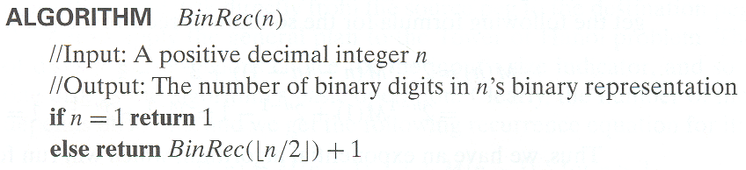
Example 3: Find the number of binary digits in the binary representation of a positive decimal integer
Compute number of additions:
A(n) = A(⎣n/2⎦)+1 with A(1) = 0

Slide 43
Smoothness Rule
Let f(n) be a nonnegative function defined on the set of natural numbers. f(n) is called smooth if it is eventually nondecreasing and
f(2n) ∈ Θ (f(n))
Functions that do not grow too fast, including logn, n, nlogn, and n^{α} where α>=0 are smooth.
Smoothness rule (Appendix B)
let T(n) be an eventually nondecreasing function and f(n) be a smooth function. If
T(n) ∈ Θ (f(n)) for values of n that are powers of b,
where b>=2, then
T(n) ∈ Θ (f(n)) for any n.
A(n) = A(⎣n/2⎦)+1 with A(1) = 0 → A(n) ∈ Θ (log n)

Slide 44
Fibonacci numbers
The Fibonacci numbers:
0, 1, 1, 2, 3, 5, 8, 13, 21, …
The Fibonacci recurrence:
F(n) = F(n-1) + F(n-2)
F(0) = 0
F(1) = 1
General 2nd order linear homogeneous recurrence with constant coefficients:
aX(n) + bX(n-1) + cX(n-2) = 0

Slide 45
Application to the Fibonacci numbers
F(n) = F(n-1) + F(n-2) or F(n) - F(n-1) - F(n-2) = 0
Characteristic equation:
Roots of the characteristic equation:
General solution to the recurrence:
Particular solution for F(0) =0, F(1)=1:

Slide 46
Important Recurrence Types
Decrease-by-one recurrences
A decrease-by-one algorithm solves a problem by exploiting a relationship between a given instance of size n and a smaller size n – 1.
Example: n!
The recurrence equation for investigating the time efficiency of such algorithms typically has the form
T(n) = T(n-1) + f(n)
Decrease-by-a-constant-factor recurrences
A decrease-by-a-constant algorithm solves a problem by dividing its given instance of size n into several smaller instances of size n/b, solving each of them recursively, and then, if necessary, combining the solutions to the smaller instances into a solution to the given instance.
Example: binary search.
The recurrence equation for investigating the time efficiency of such algorithms typically has the form
T(n) = aT(n/b) + f (n)

Slide 47
Decrease-by-one Recurrences
One (constant) operation reduces problem size by one.
T(n) = T(n-1) + c T(1) = d
Solution:
A pass through input reduces problem size by one.
T(n) = T(n-1) + c n T(1) = d
Solution:
T(n) = (n-1)c + d linear
T(n) = [n(n+1)/2 – 1] c + d quadratic

Slide 48
Decrease-by-a-constant-factor recurrences – The Master Theorem
T(n) = aT(n/b) + f (n), where f (n) ∈ Θ(n^{k}) , k>=0
a < b^{k} T(n) ∈ Θ(n^{k})
a = b^{k} T(n) ∈ Θ(n^{k} log n )
a > b^{k} T(n) ∈ Θ(n^{log b a})
Examples:
T(n) = T(n/2) + 1
T(n) = 2T(n/2) + n
T(n) = 3 T(n/2) + n
Θ(logn)
Θ(nlogn)
Θ(n^{log}₂³)

